Slide 1
Performance Evaluation of Channel Estimation Techniques under Doppler Effects in IEEE 802.11 Rician Channels
Yusuf Emre BAYSAL

Slide 2
Contents
Goal
Introduction
OFDM
LEO Communication
Theoretical Background
MATLAB’s Image Transmission Example
LS and MMSE Estimators
802.11 Preamble Signals
Doppler
Methodology
Transmitter Design
Communication Channel
Receiver Design
Simulation Results
Conclusion

Slide 3
GOAL

Slide 4
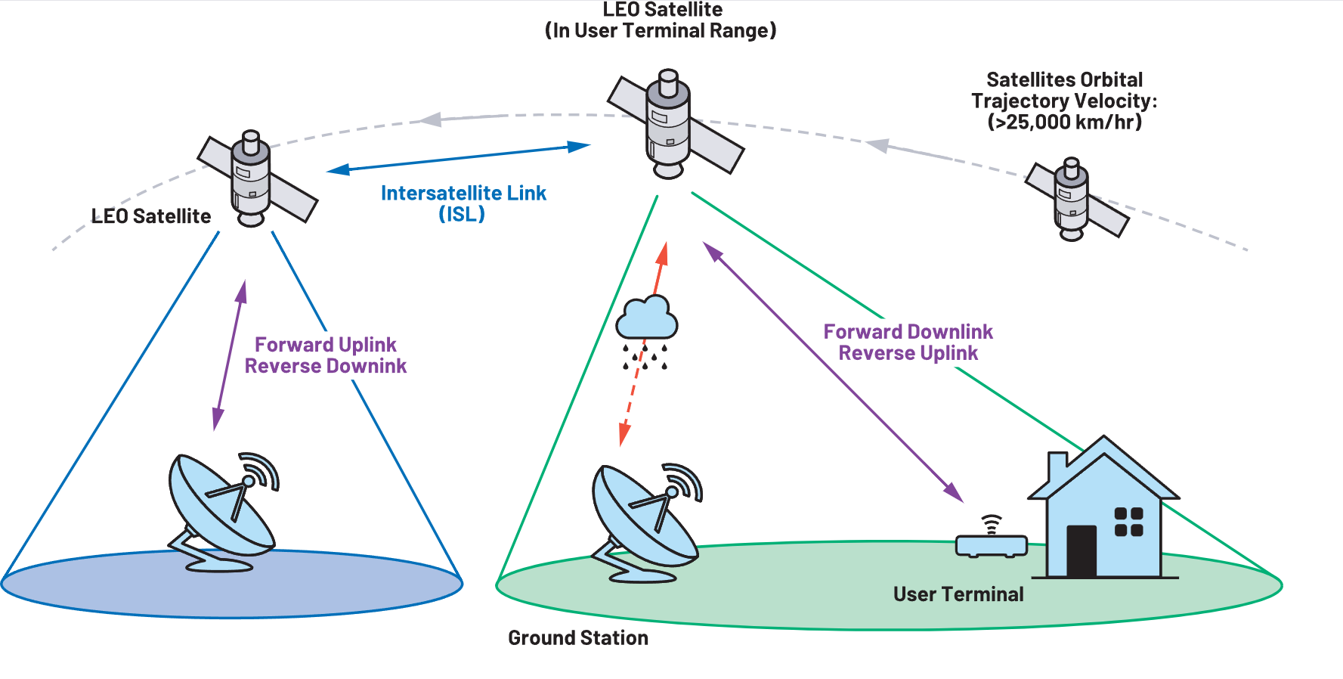
LEO Ground Communication with OFDM Based Communication Techniques

Slide 5
Introductıon

Slide 6
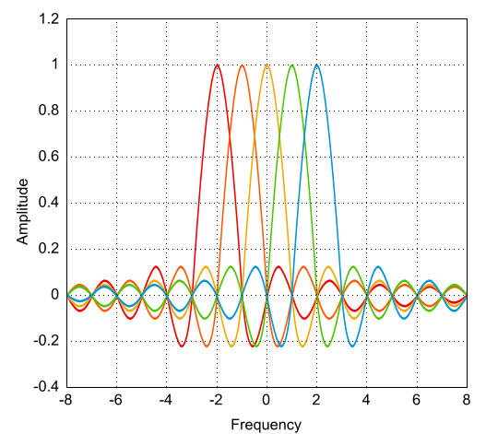
OFDM
OFDM (Orthogonal Frequency Division Multiplexing) is a multi-carrier modulation technique that transmits data by dividing it into multiple subcarriers, making it resilient to frequency-selective fading and interference, and ideal for high-speed communication systems.

Slide 7
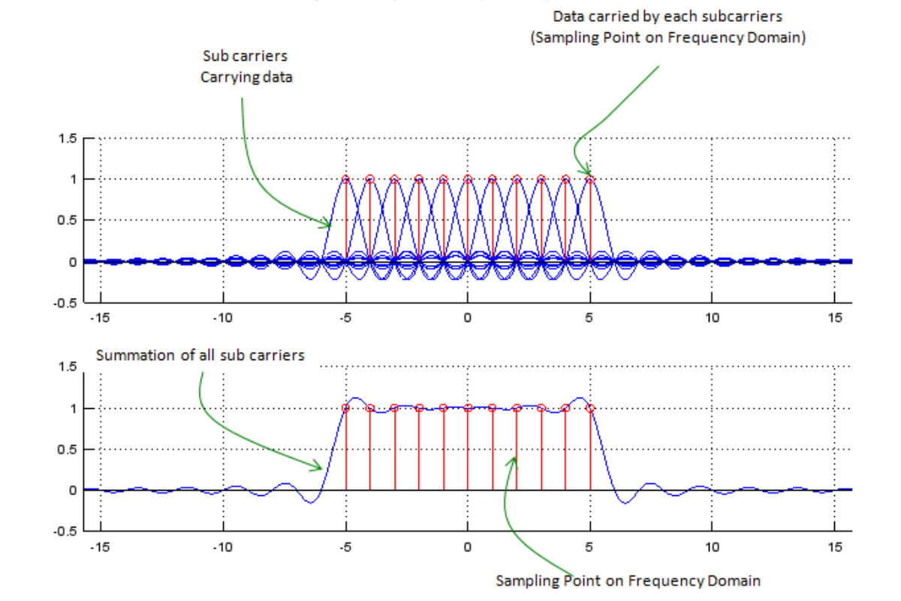
OFDM
WiFi: IEEE 802.11a, 802.11g, 802.11n, 802.11ac, and 802.11ax
LTE
5G NR

Slide 8
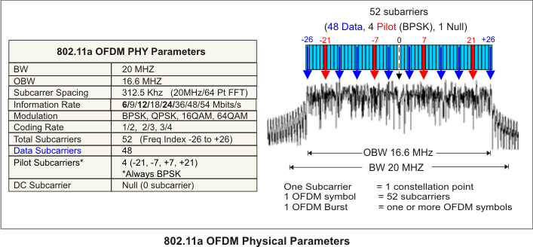
WiFi Standart: IEEE 802.11
Wi-Fi is a wireless networking standard based on IEEE 802.11, enabling devices to connect to the internet or communicate with each other over short distances using radio waves.
The 802.11a standard is a Wi-Fi specification introduced in 1999 that operates in the 5 GHz band, offering data rates up to 54 Mbps. It uses OFDM (Orthogonal Frequency Division Multiplexing) for efficient data transmission and is less prone to interference compared to 2.4 GHz networks but has a shorter range.

Slide 9
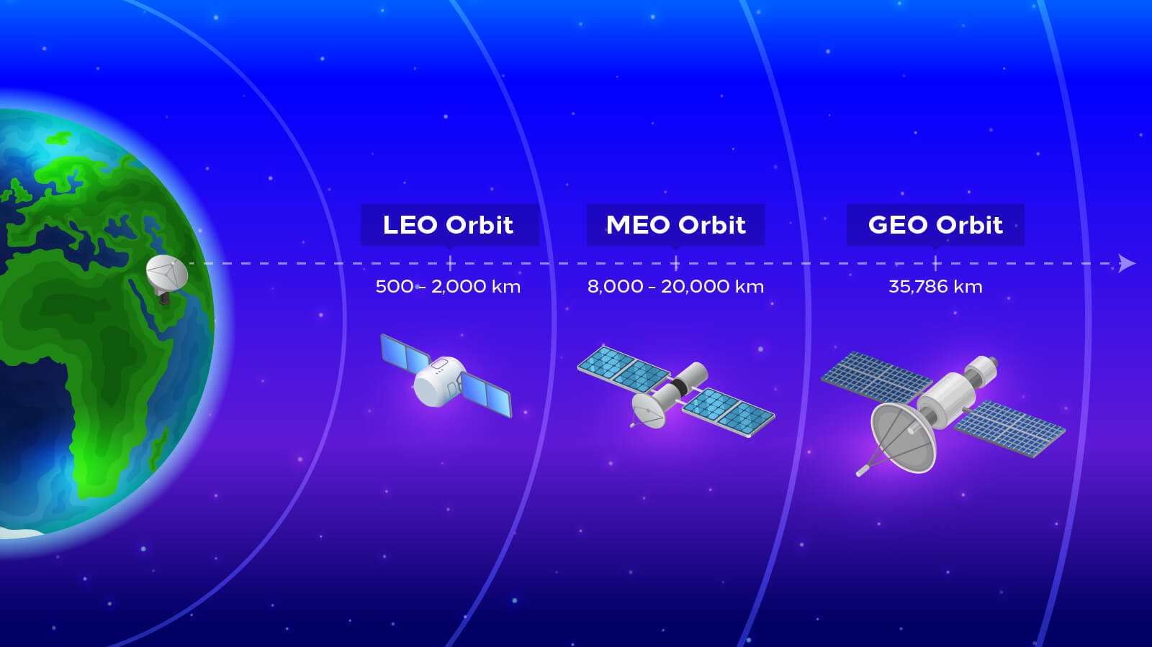
Low Earth Orbit
LEO (Low Earth Orbit) is an orbit around Earth at altitudes between 500 and 2,000 km, commonly used for satellites requiring low latency and high-resolution observations.

Slide 10
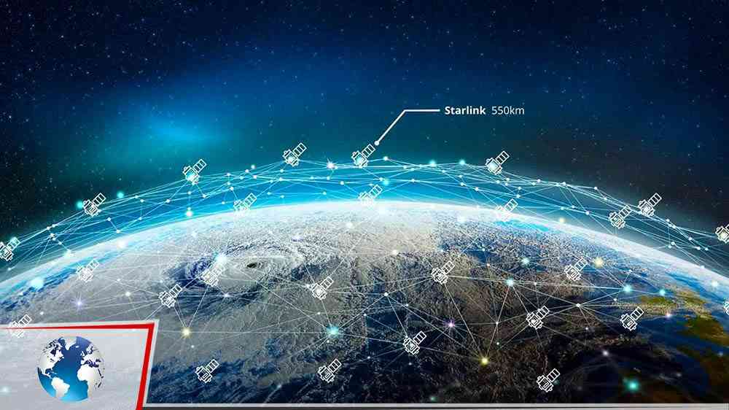
Starlink
Starlink is a satellite internet constellation developed by SpaceX to provide high-speed, low-latency broadband internet worldwide, especially in remote and underserved areas.

Slide 11
Theoretıcal Background

Slide 12
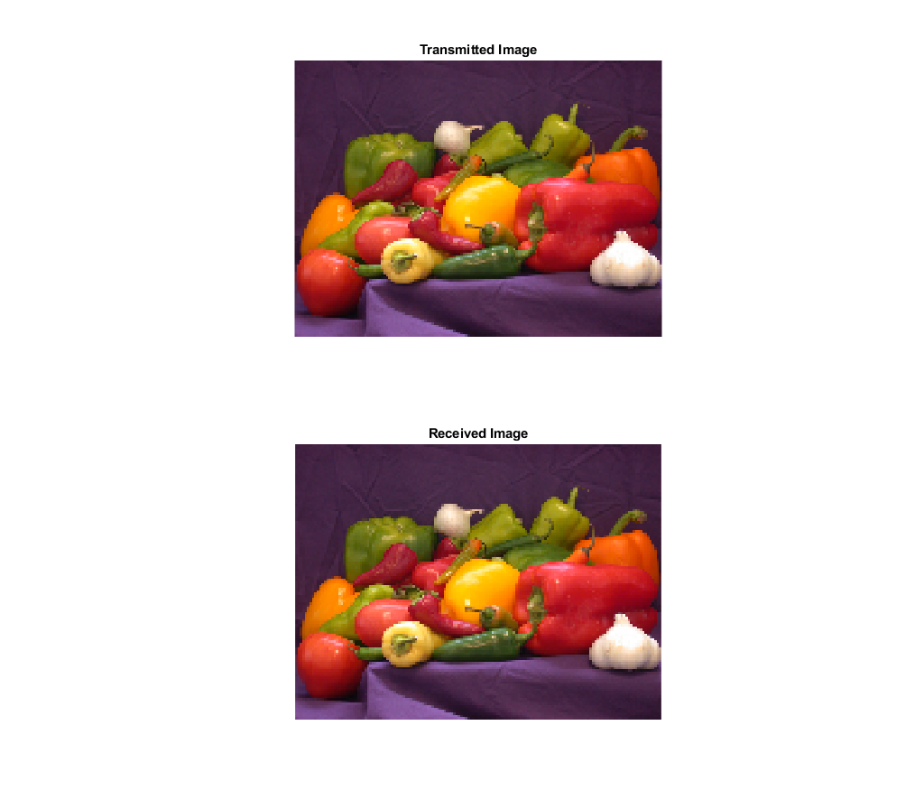
MATLAB IEEE 802.11 Image Transmission Example
This example shows how to encode and pack an image file into WLAN packets for transmission and subsequently decode the packets to retrieve the image.

Slide 13
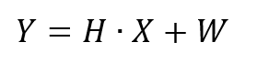
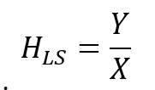
Least Squares Estimator
Least Squares (LS) is a mathematical method used in channel estimation to minimize the error between observed and expected signals, providing a simple and computationally efficient way to estimate channel responses without considering noise statistics.

Slide 14
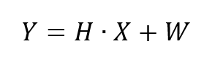
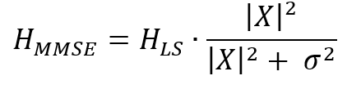
Minimum Mean Square Error Estimator
Minimum Mean Square Error (MMSE) is an advanced channel estimation technique that minimizes the mean square error by incorporating noise statistics and prior channel information, offering higher accuracy in noisy environments compared to simpler methods like LS.

Slide 15
MATLAB’s Estimation Algorithm in MATLAB IEEE 802.11 Image Transmission Example
The wlanLLTFChannelEstimate function in MATLAB estimates channels for IEEE 802.11 packets using Long Training Field (L-LTF) with LS as the primary method and optional frequency smoothing to reduce noise.

Slide 16
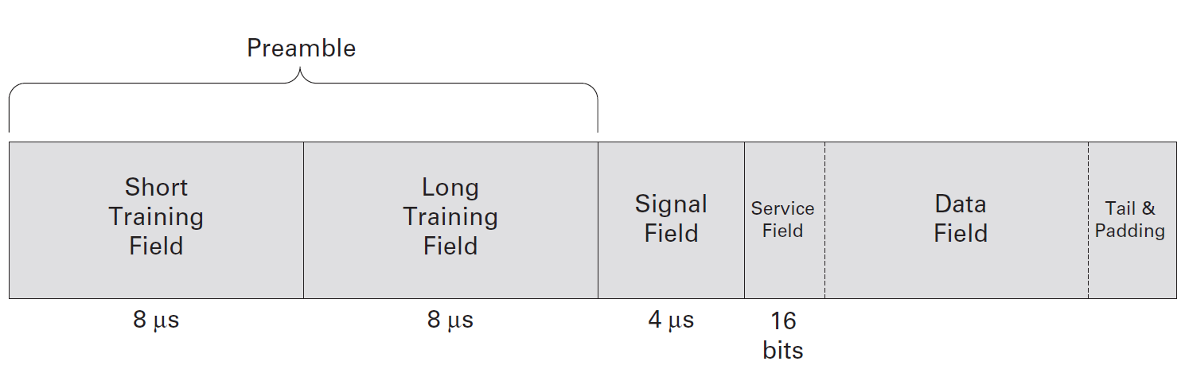
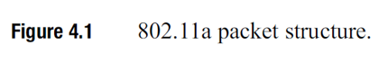
Preamble Signals in IEEE 802.11 to be Used to Estimate Channel
802.11a Packet Structure
The 802.11a packet structure ensures reliable communication with specific fields: STF for synchronization, LTF for channel estimation, SIG for transmission rate and packet length, and the Data Field for payload transmission.

Slide 17
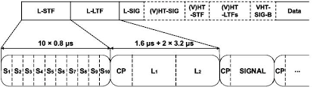
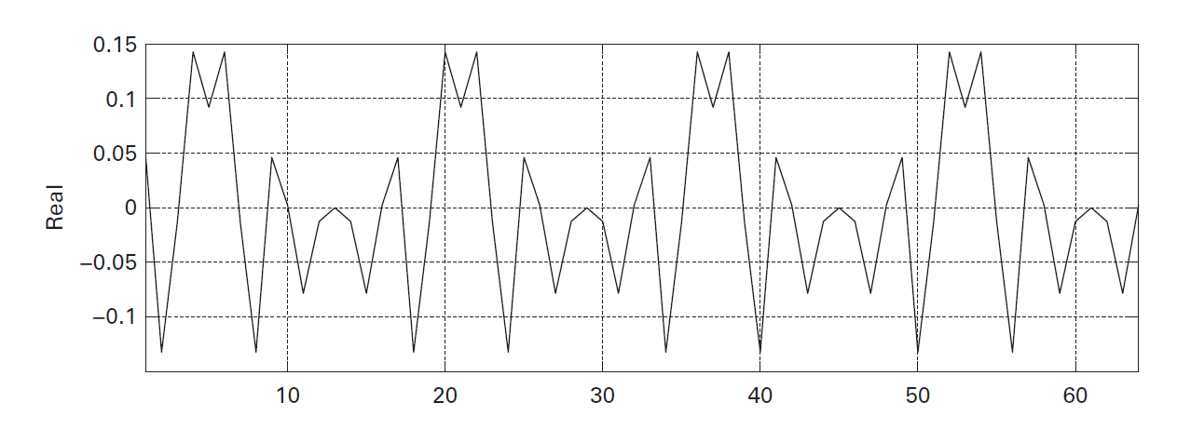
Short Time Training Field
The Short Training Field (STF) is an 8 μs signal used for:
Packet detection
Auto Gain Control settings
Frequency offset estimation
Time synchronization
with a periodic structure for efficient synchronization.

Slide 18
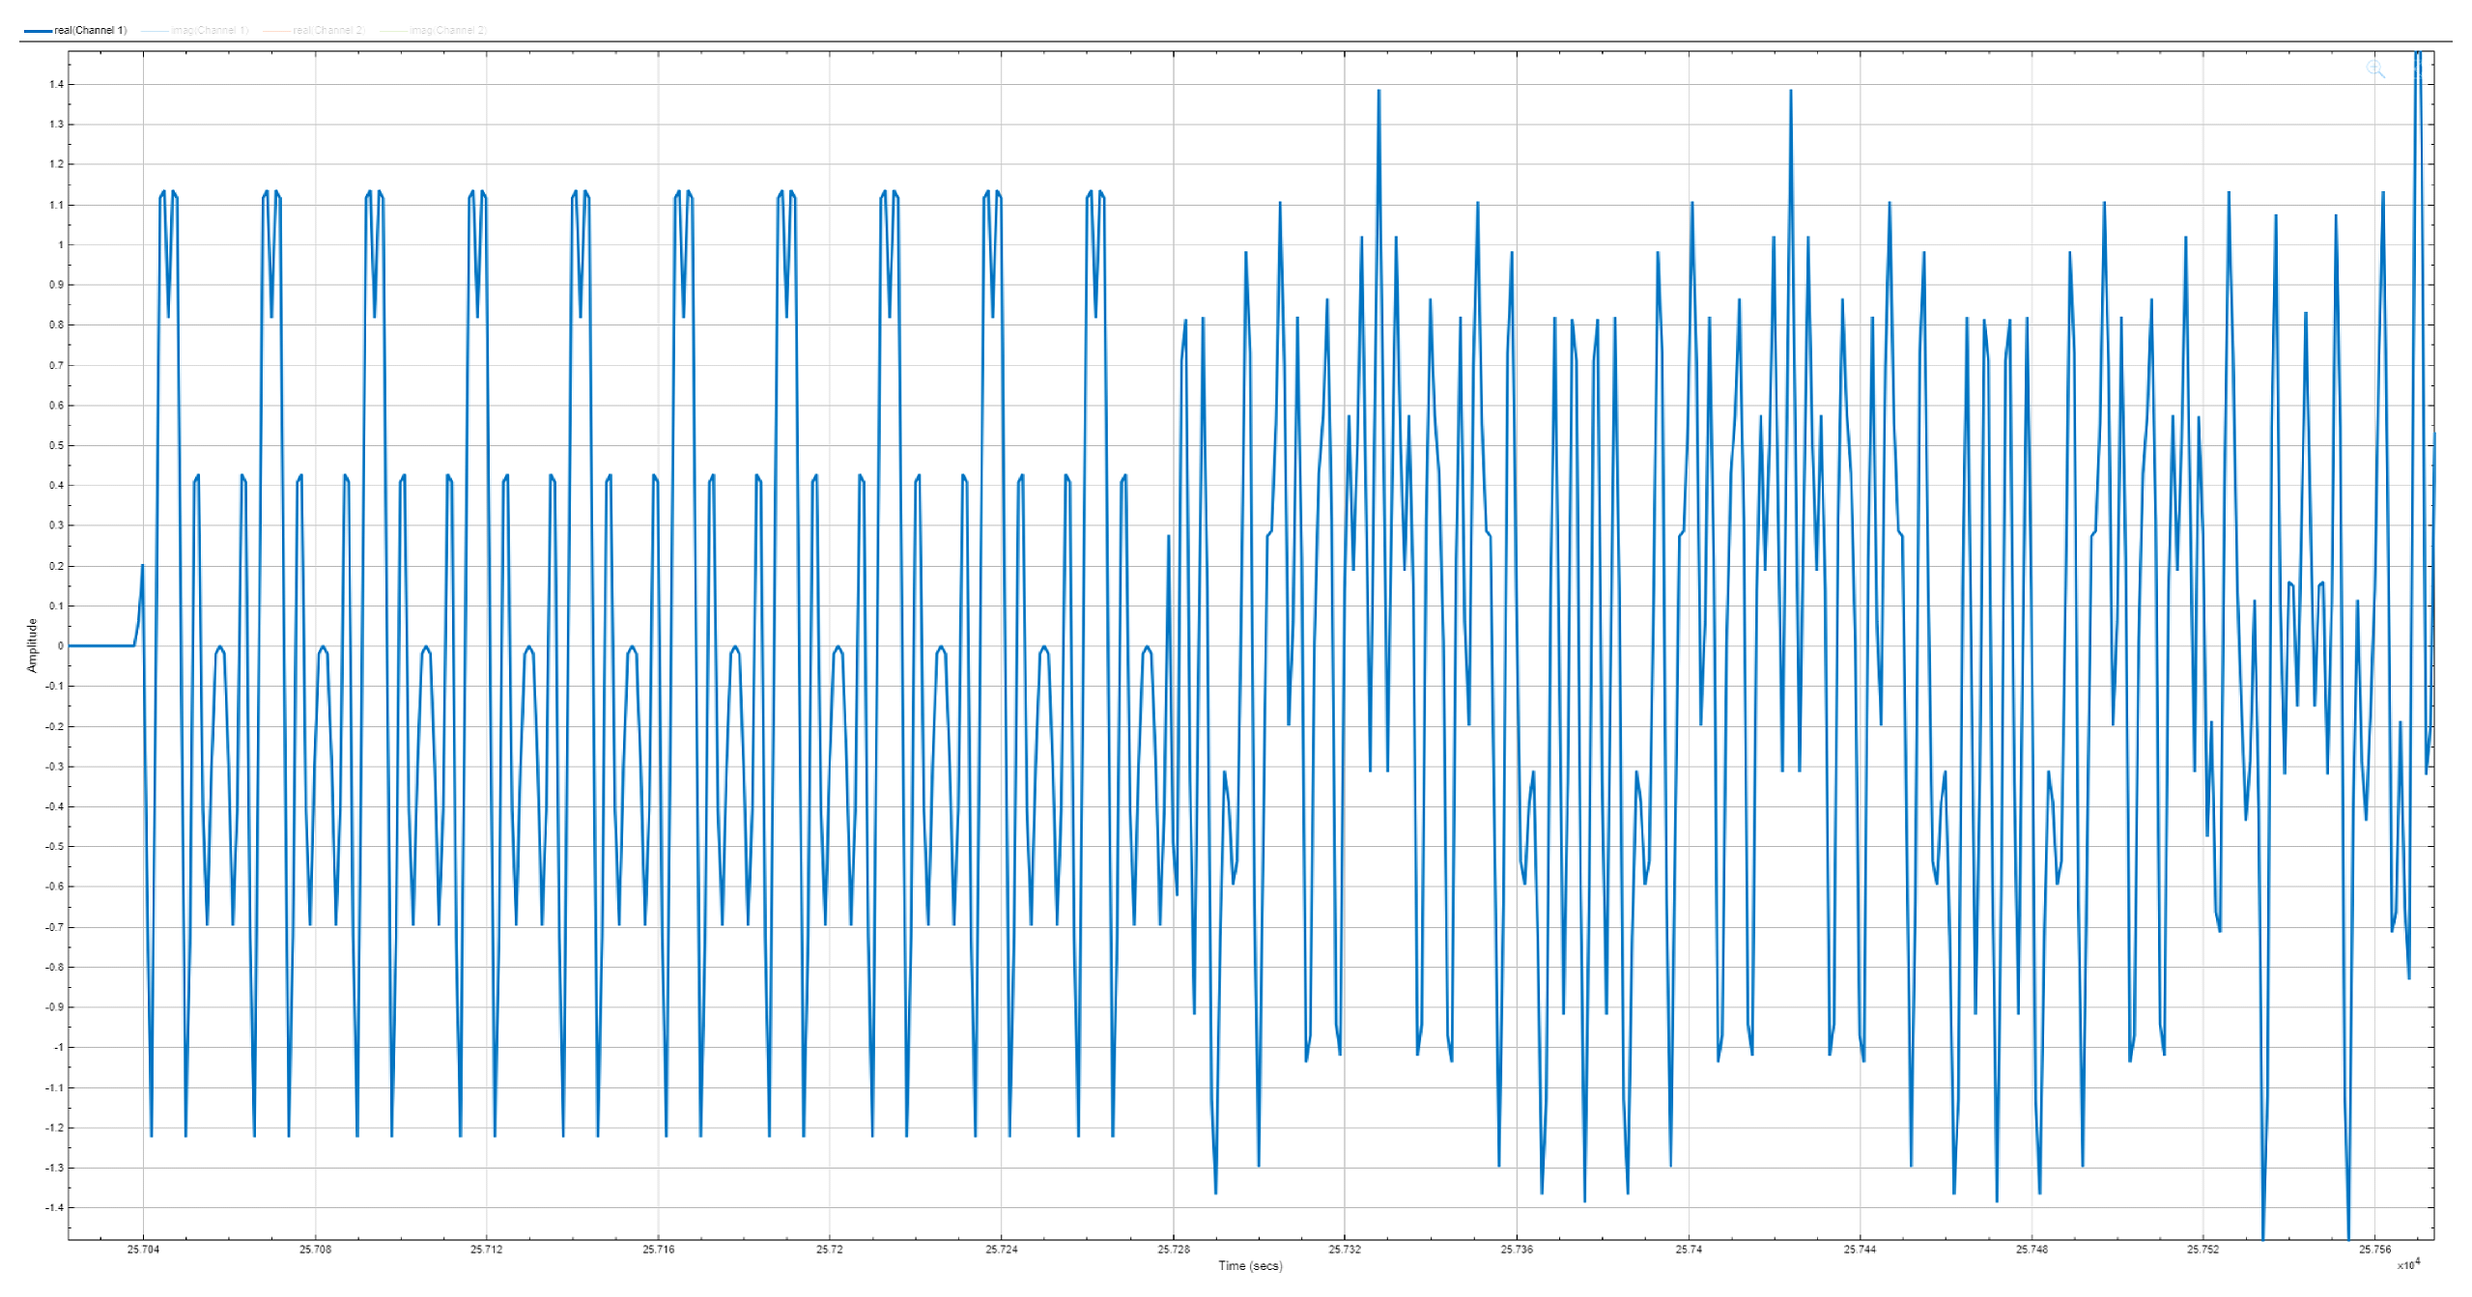
Long Time Training Field
The Long Training Field (LTF) is an 8 μs signal used in 802.11a communication for:
Channel Estimation
frequency offset
time synchronization
featuring two 3.2 μs symbols with 1.6 μs cyclic prefixes for multipath resilience.

Slide 19
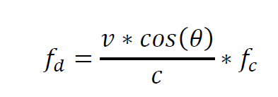
Doppler
It refers to the apparent change in frequency of a signal caused by the relative motion between the transmitter and the receiver.

Slide 20
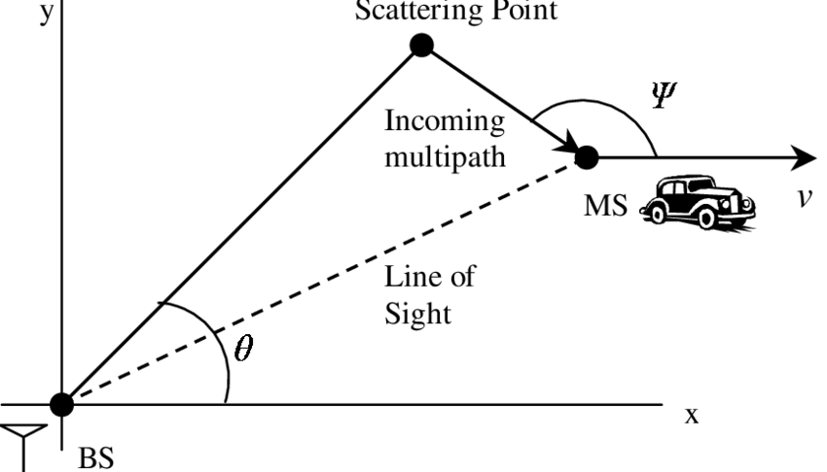
Doppler
Shorter Coherence Time:
In fast-moving environments, the channel characteristics change rapidly, making channel estimation outdated quickly.
Frequency Offset:
Causes a shift in carrier frequency, leading to loss of orthogonality in OFDM systems.
Results in Inter-Carrier Interference (ICI), degrading signal quality.
Synchronization Issues:
Doppler introduces challenges in maintaining time and frequency synchronization, leading to higher Bit Error Rates (BER).

Slide 21
Methodology

Slide 22

MATLAB IEEE 802.11 Image Transmission Example
The MATLAB IEEE 802.11 image transmission example simulate and analyze wireless communication by processing data through MAC and PHY layers.

Slide 23
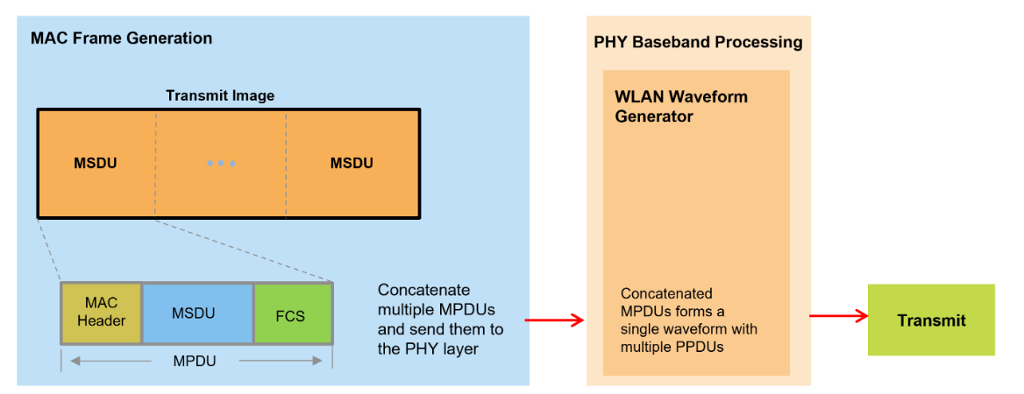
Transmitter Design
The transmitter design in the MATLAB simulation involves preparing data, scaling the image into a binary stream, segmenting it into smaller packets, padding the empty fields and packing it into 802.11a WLAN packets using the WLAN Toolbox. These packets are then converted into a baseband signal for transmission.

Slide 24
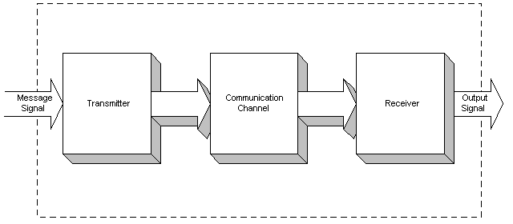
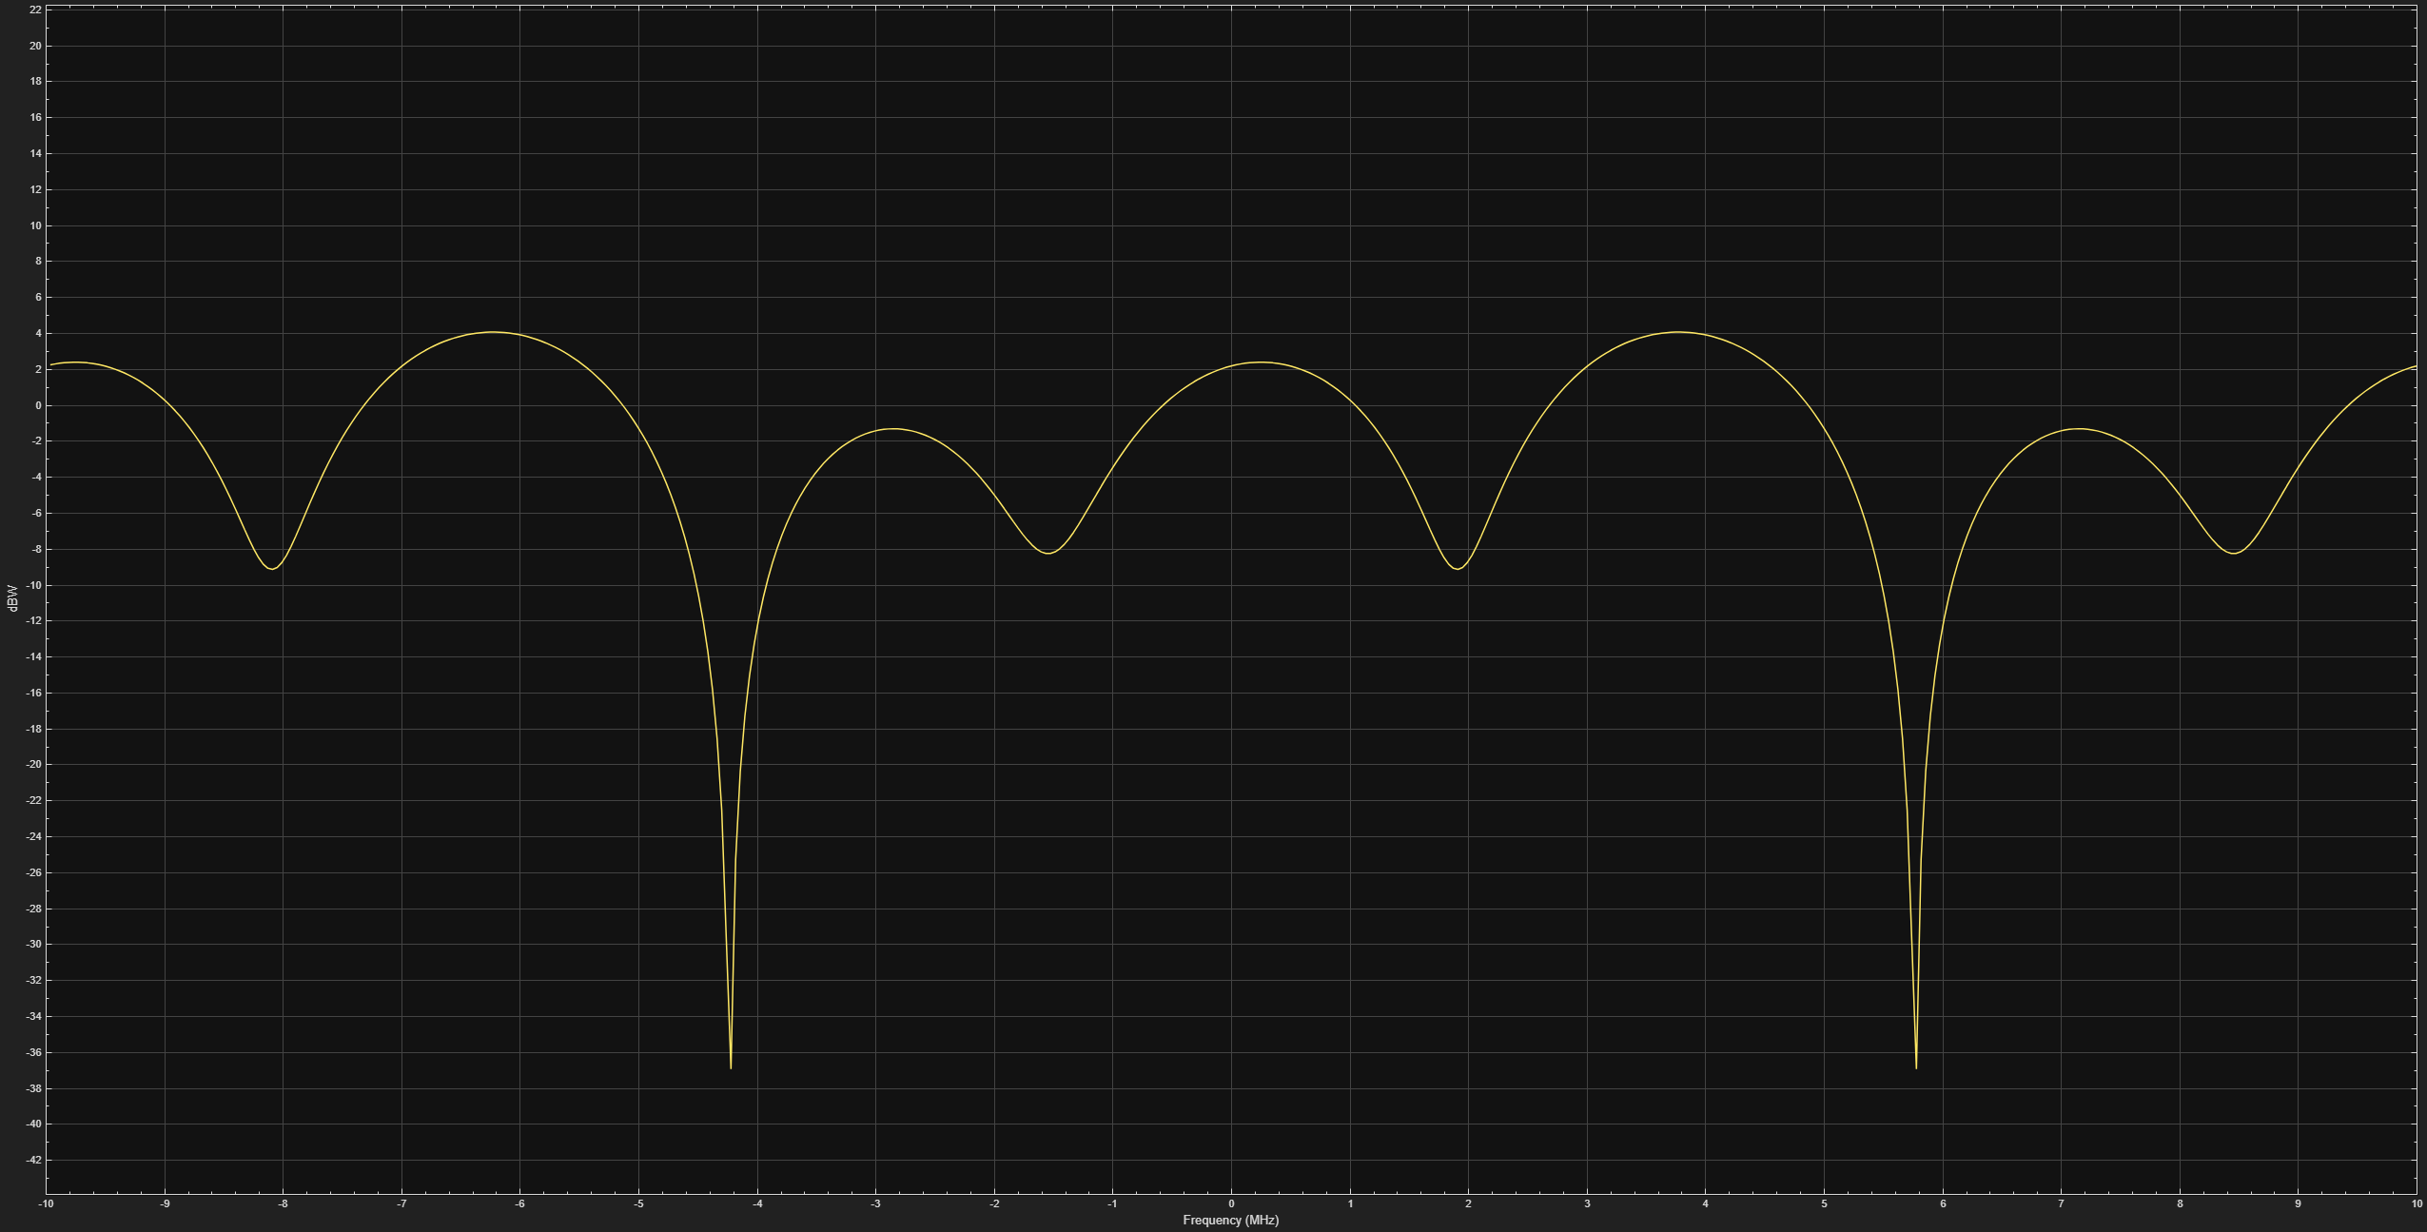
Communication Channel
In the communication channel, the signal first passes through a Rician communication channel, which simulates multipath propagation with a dominant line-of-sight component.
Afterward, Additive White Gaussian Noise (AWGN) is introduced to the signal to simulate real-world noise and further degrade its quality for testing robustness.

Slide 25
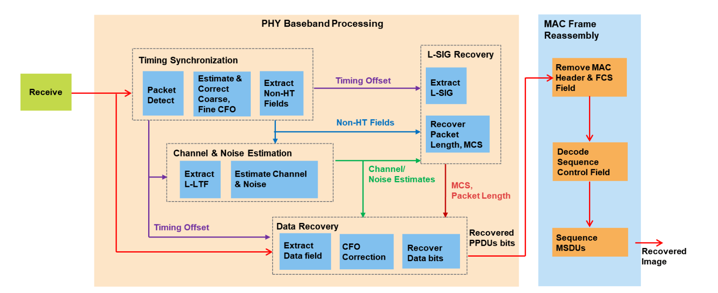
Receiver Design
1. Detects a packet and establishes synchronization through coarse and fine carrier frequency offset estimation and correction.
2. Performs channel estimation using the L-LTF to determine the channel response.
3. Identifies the packet format and decodes the L-SIG field to extract the modulation and coding scheme (MCS) and the data length.
4. Decodes the data field, reconstructing the PSDU while verifying the frame check sequence (FCS) for errors.
5. Orders and combines the decoded MSDUs from all packets based on their sequence numbers to recreate the transmitted image.

Slide 26
Receiver Design
The received noisy signal is decoded by combining the decoded MSDUs from all the transmitted packets to form the received image

Slide 27
Sımulatıons and Results

Slide 28
Simulation Parameters
Simulayion Parameters
Rican Channel Parameters
Variable | Value
Modulation | 16 QAM
Coding Rate | 1/2
Number of Transmitted Packets | 11 packets
Payload Length (MSDU) | 2304 bytes
Packet Length (MPDU) | 2332 bytes
SNR Level | 20 dB
Variable | Value
Sample Rate | 20e6
Path Delays (seconds) | [0 0.5e-06 1.2e-06]
Average Path Gains (dB) | [0 -3 -6]
K-Factor | 10
Direct Path Doppler Shift | 0 Hz to 5000 Hz
Maximum Doppler Shift | 0 Hz to 5000 Hz
Channel Filtering | true
Path Gains Output Port | true

Slide 29
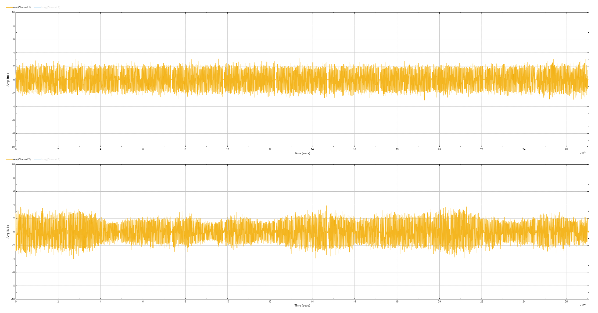
TX and RX Signal
Top: TX, Bottom: RX

Slide 30
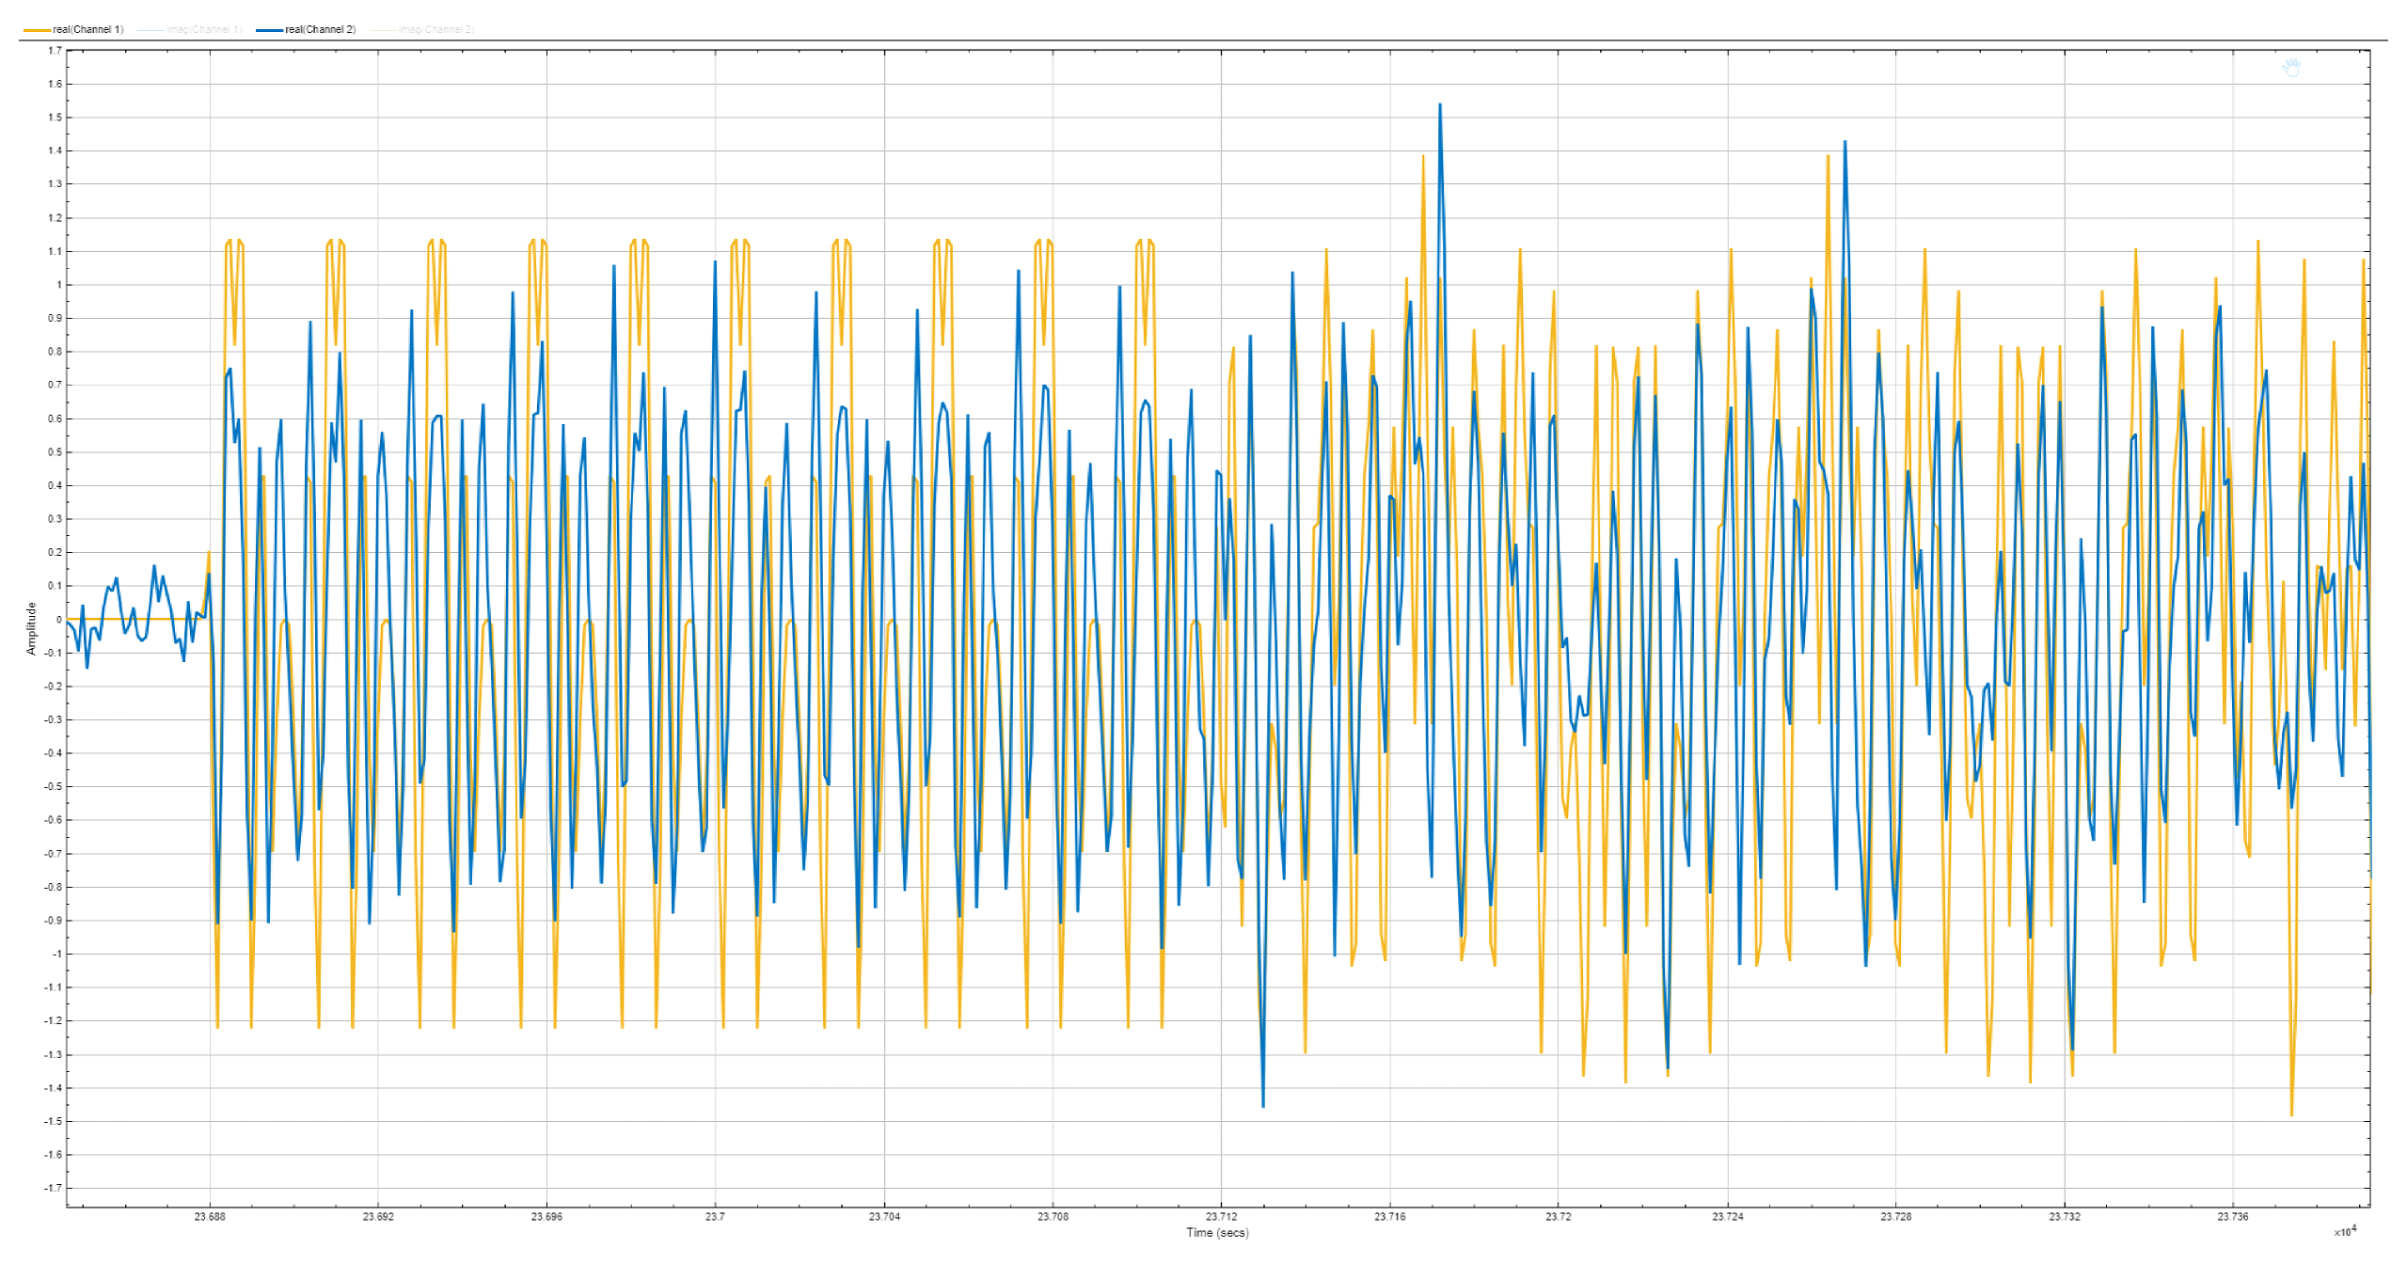
TX and RX Signal: L-STF and L-LTF Fields
Yellow: TX, Blue: RX

Slide 31
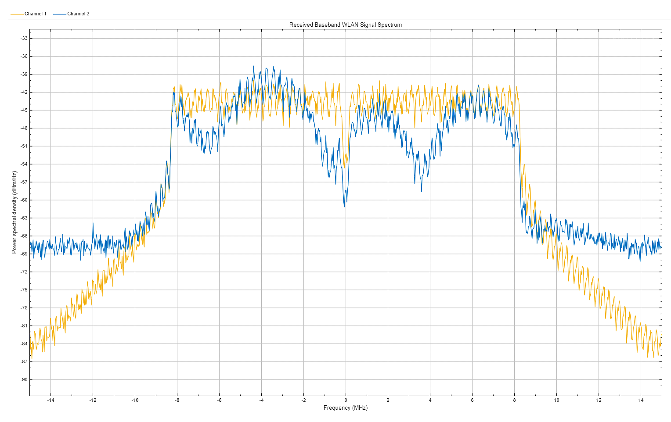
TX and RX Signal: Signal Spectrum
Yellow: TX, Blue: RX

Slide 32
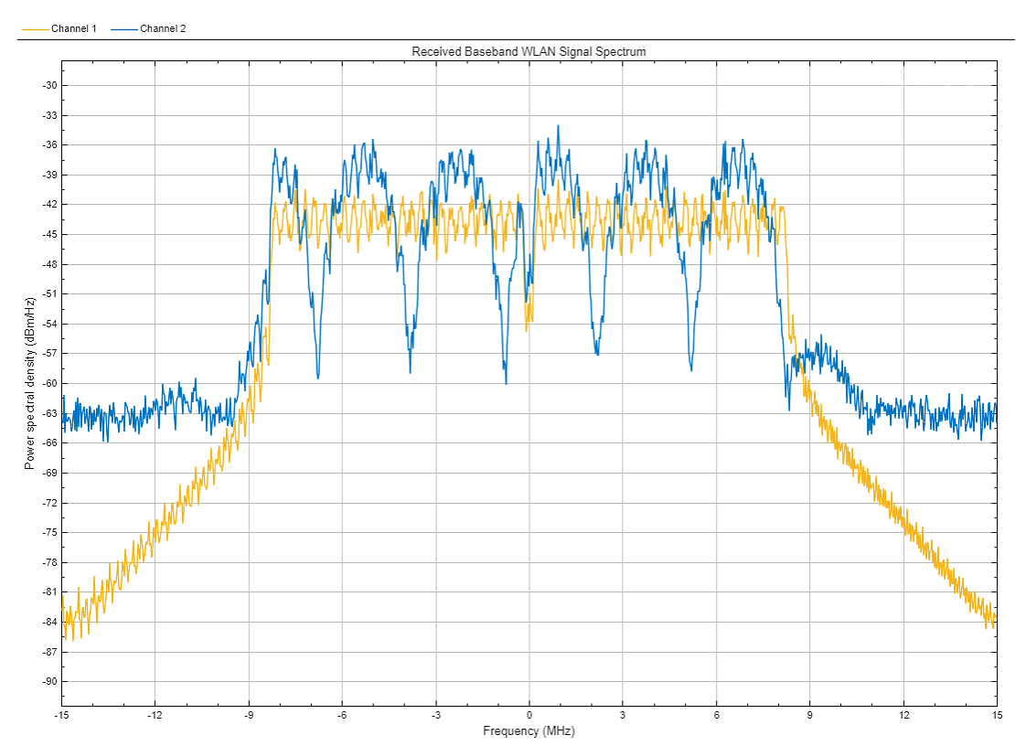
TX and RX Signal: Signal Spectrum
Yellow: TX, Blue: RX

Slide 33
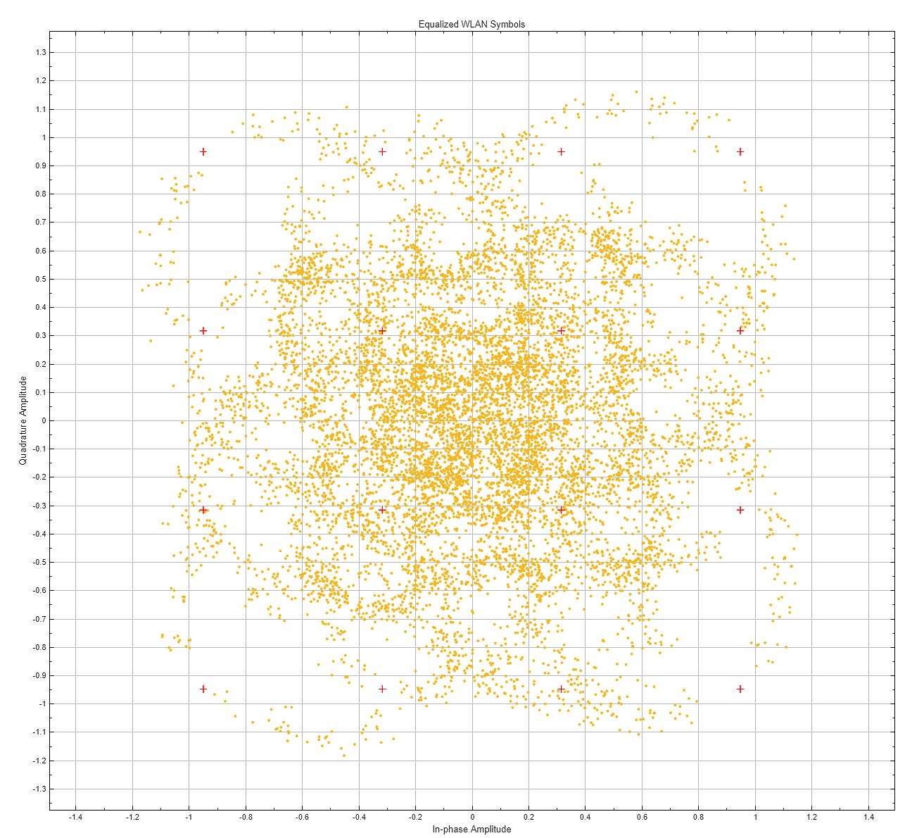
Constellation Diagram Without Estimator
Yellow: TX, Blue: RX

Slide 34
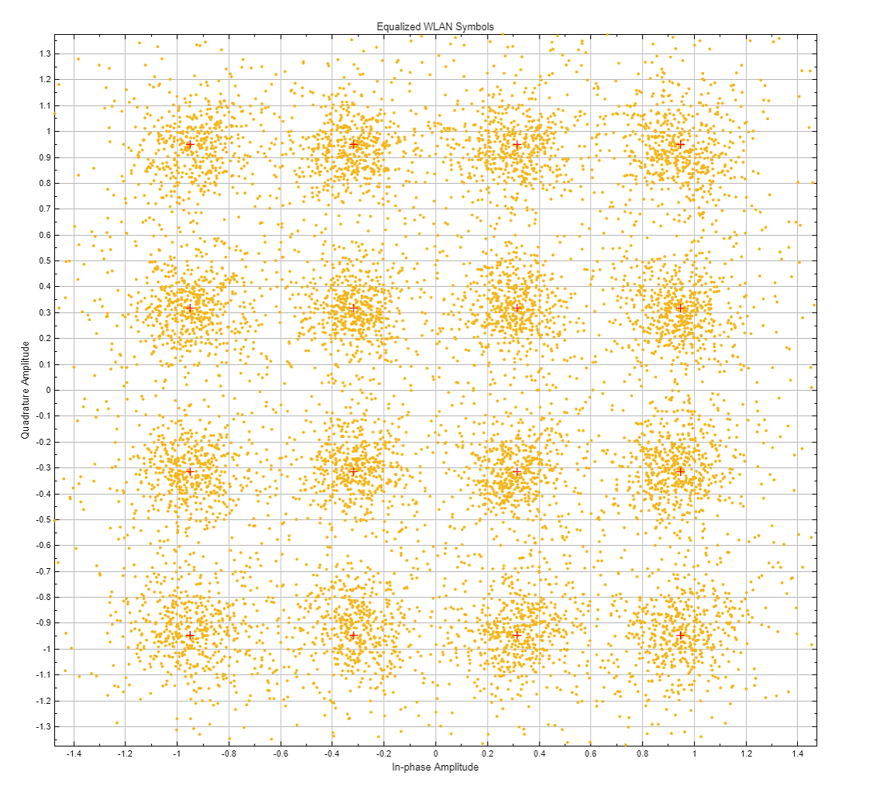
Constellation Diagram With LS Estimator
Yellow: TX, Blue: RX

Slide 35
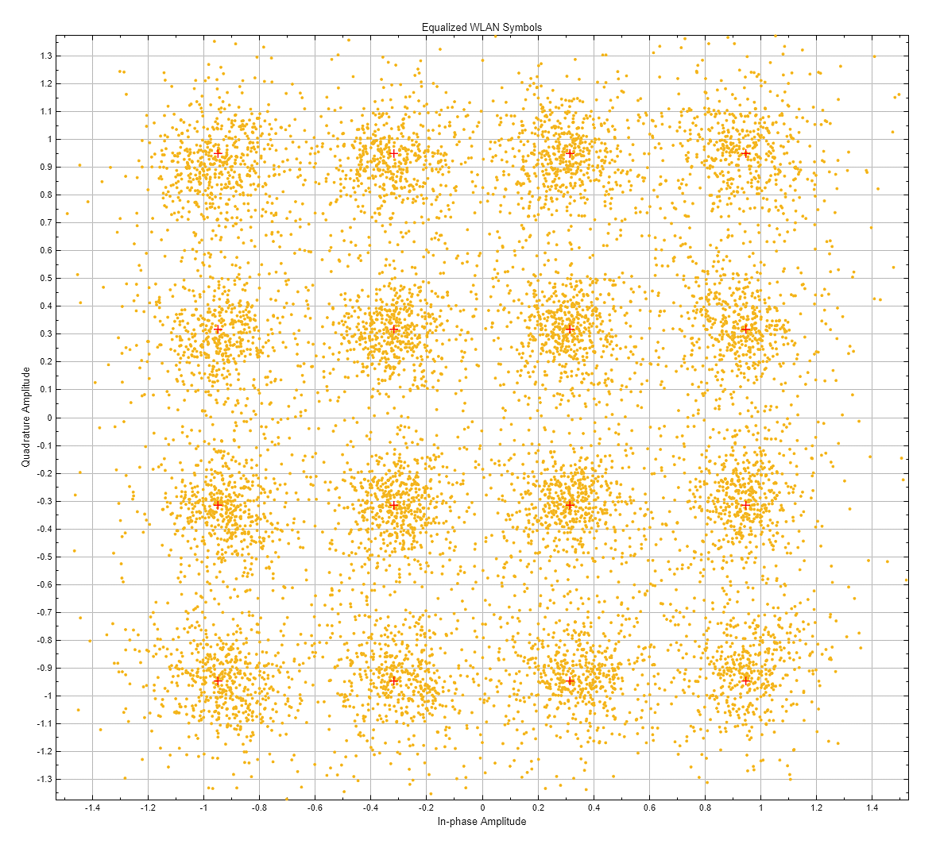
Constellation Diagram With MMSE Estimator
Yellow: TX, Blue: RX

Slide 36
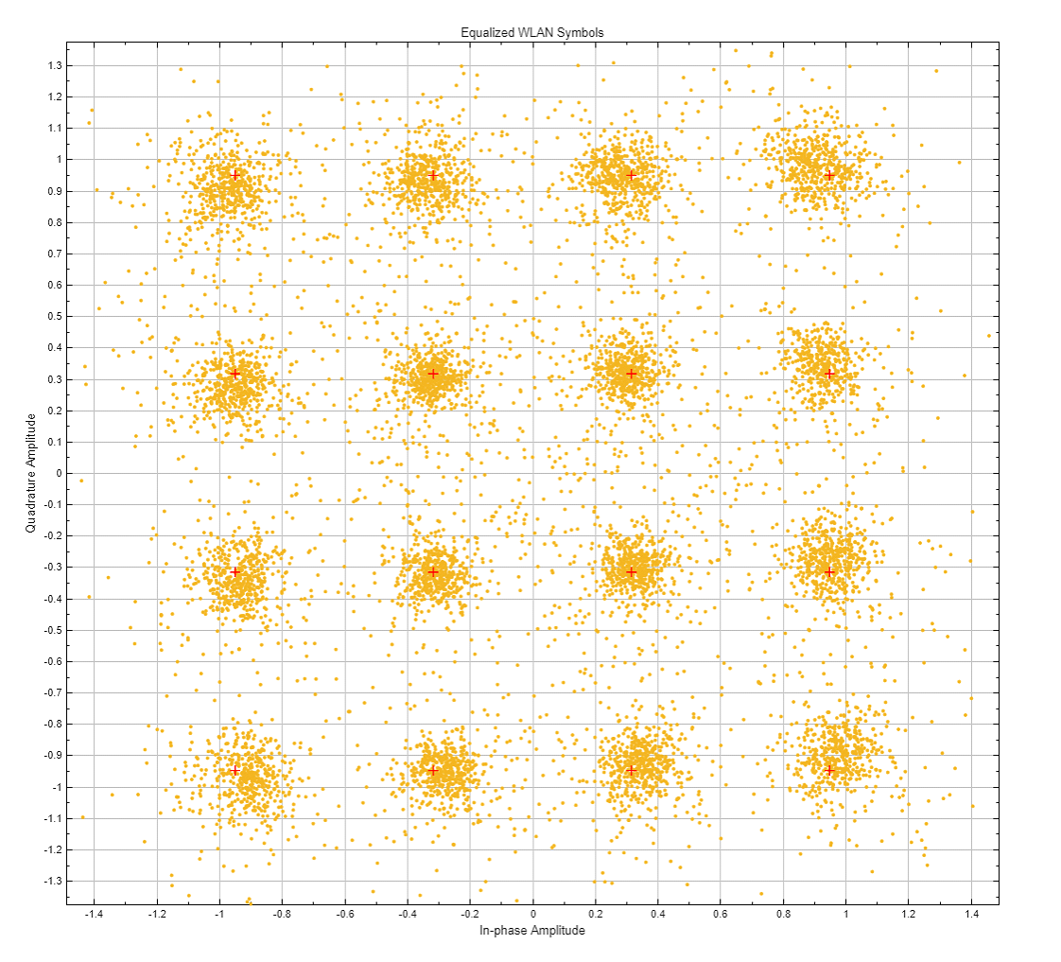
Constellation Diagram With Matlab Estimator
Yellow: TX, Blue: RX

Slide 37
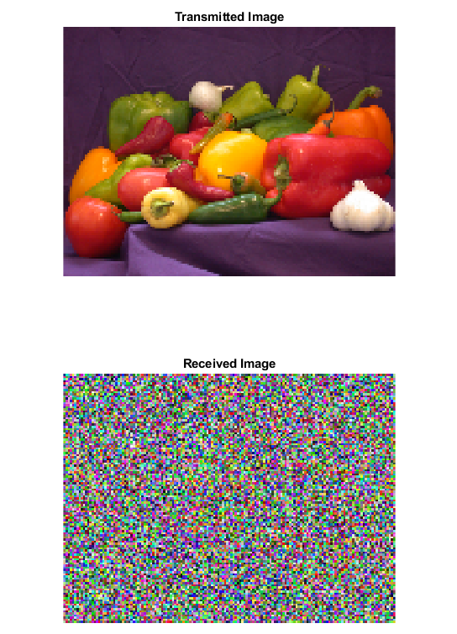
TX and RX Image
Doppler: 0 Hz, BER: 0
Doppler: 0 Hz, Without Estimator

Slide 38
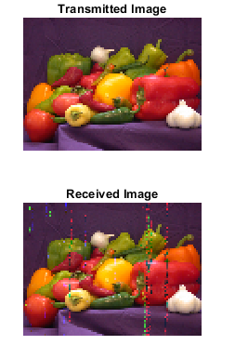
TX and RX Image
Doppler: 0 Hz, BER: 0
Doppler: 500 Hz. BER: 0.00992

Slide 39

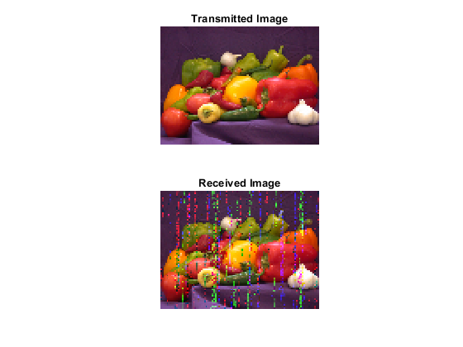
TX and RX Image
Doppler: 1000 Hz. BER: 0.01676
Doppler: 1500 Hz. BER: 0.04346

Slide 40
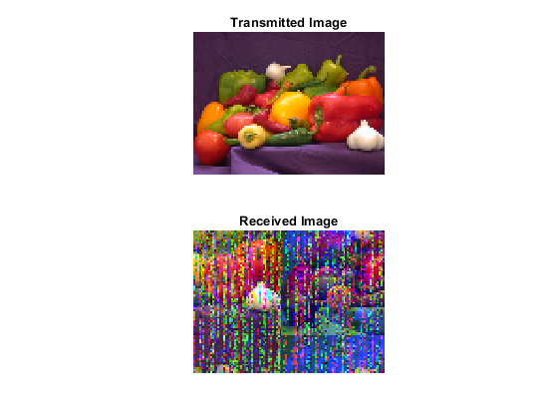
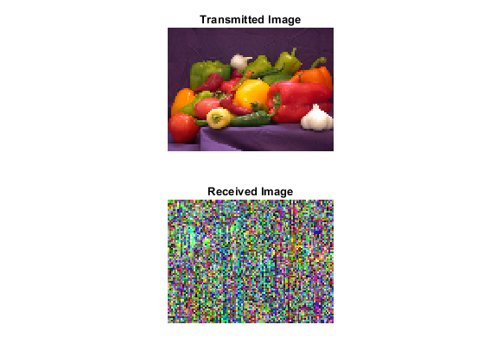
TX and RX Image
Doppler: 2500 Hz. BER: 0.48775
Doppler: 5000 Hz. BER: 0.49634

Slide 41
Monte Carlo Simulation Parameters
Simulation Parameters
Rican Channel Parameters
Variable | Value
Modulation | 16 QAM
Coding Rate | 1/2
Number of Transmitted Packets | 233 packets
Payload Length (MSDU) | 100 bytes
Packet Length (MPDU) | 128 bytes
SNR Level | 20 dB
Monte Carlo Iteration Count | 200
Doppler Vector | 0 to 5000 Hz, 50 Hz increments
Variable | Value
Sample Rate | 20e6
Path Delays (seconds) | [0 0.1e-06 0.3e-06]
Average Path Gains (dB) | [0 -1 -2]
K-Factor | 30
Direct Path Doppler Shift | 0 to 5000 Hz, 50 Hz increments
Maximum Doppler Shift | 0 to 5000 Hz, 50 Hz increments
Channel Filtering | true
Path Gains Output Port | true

Slide 42
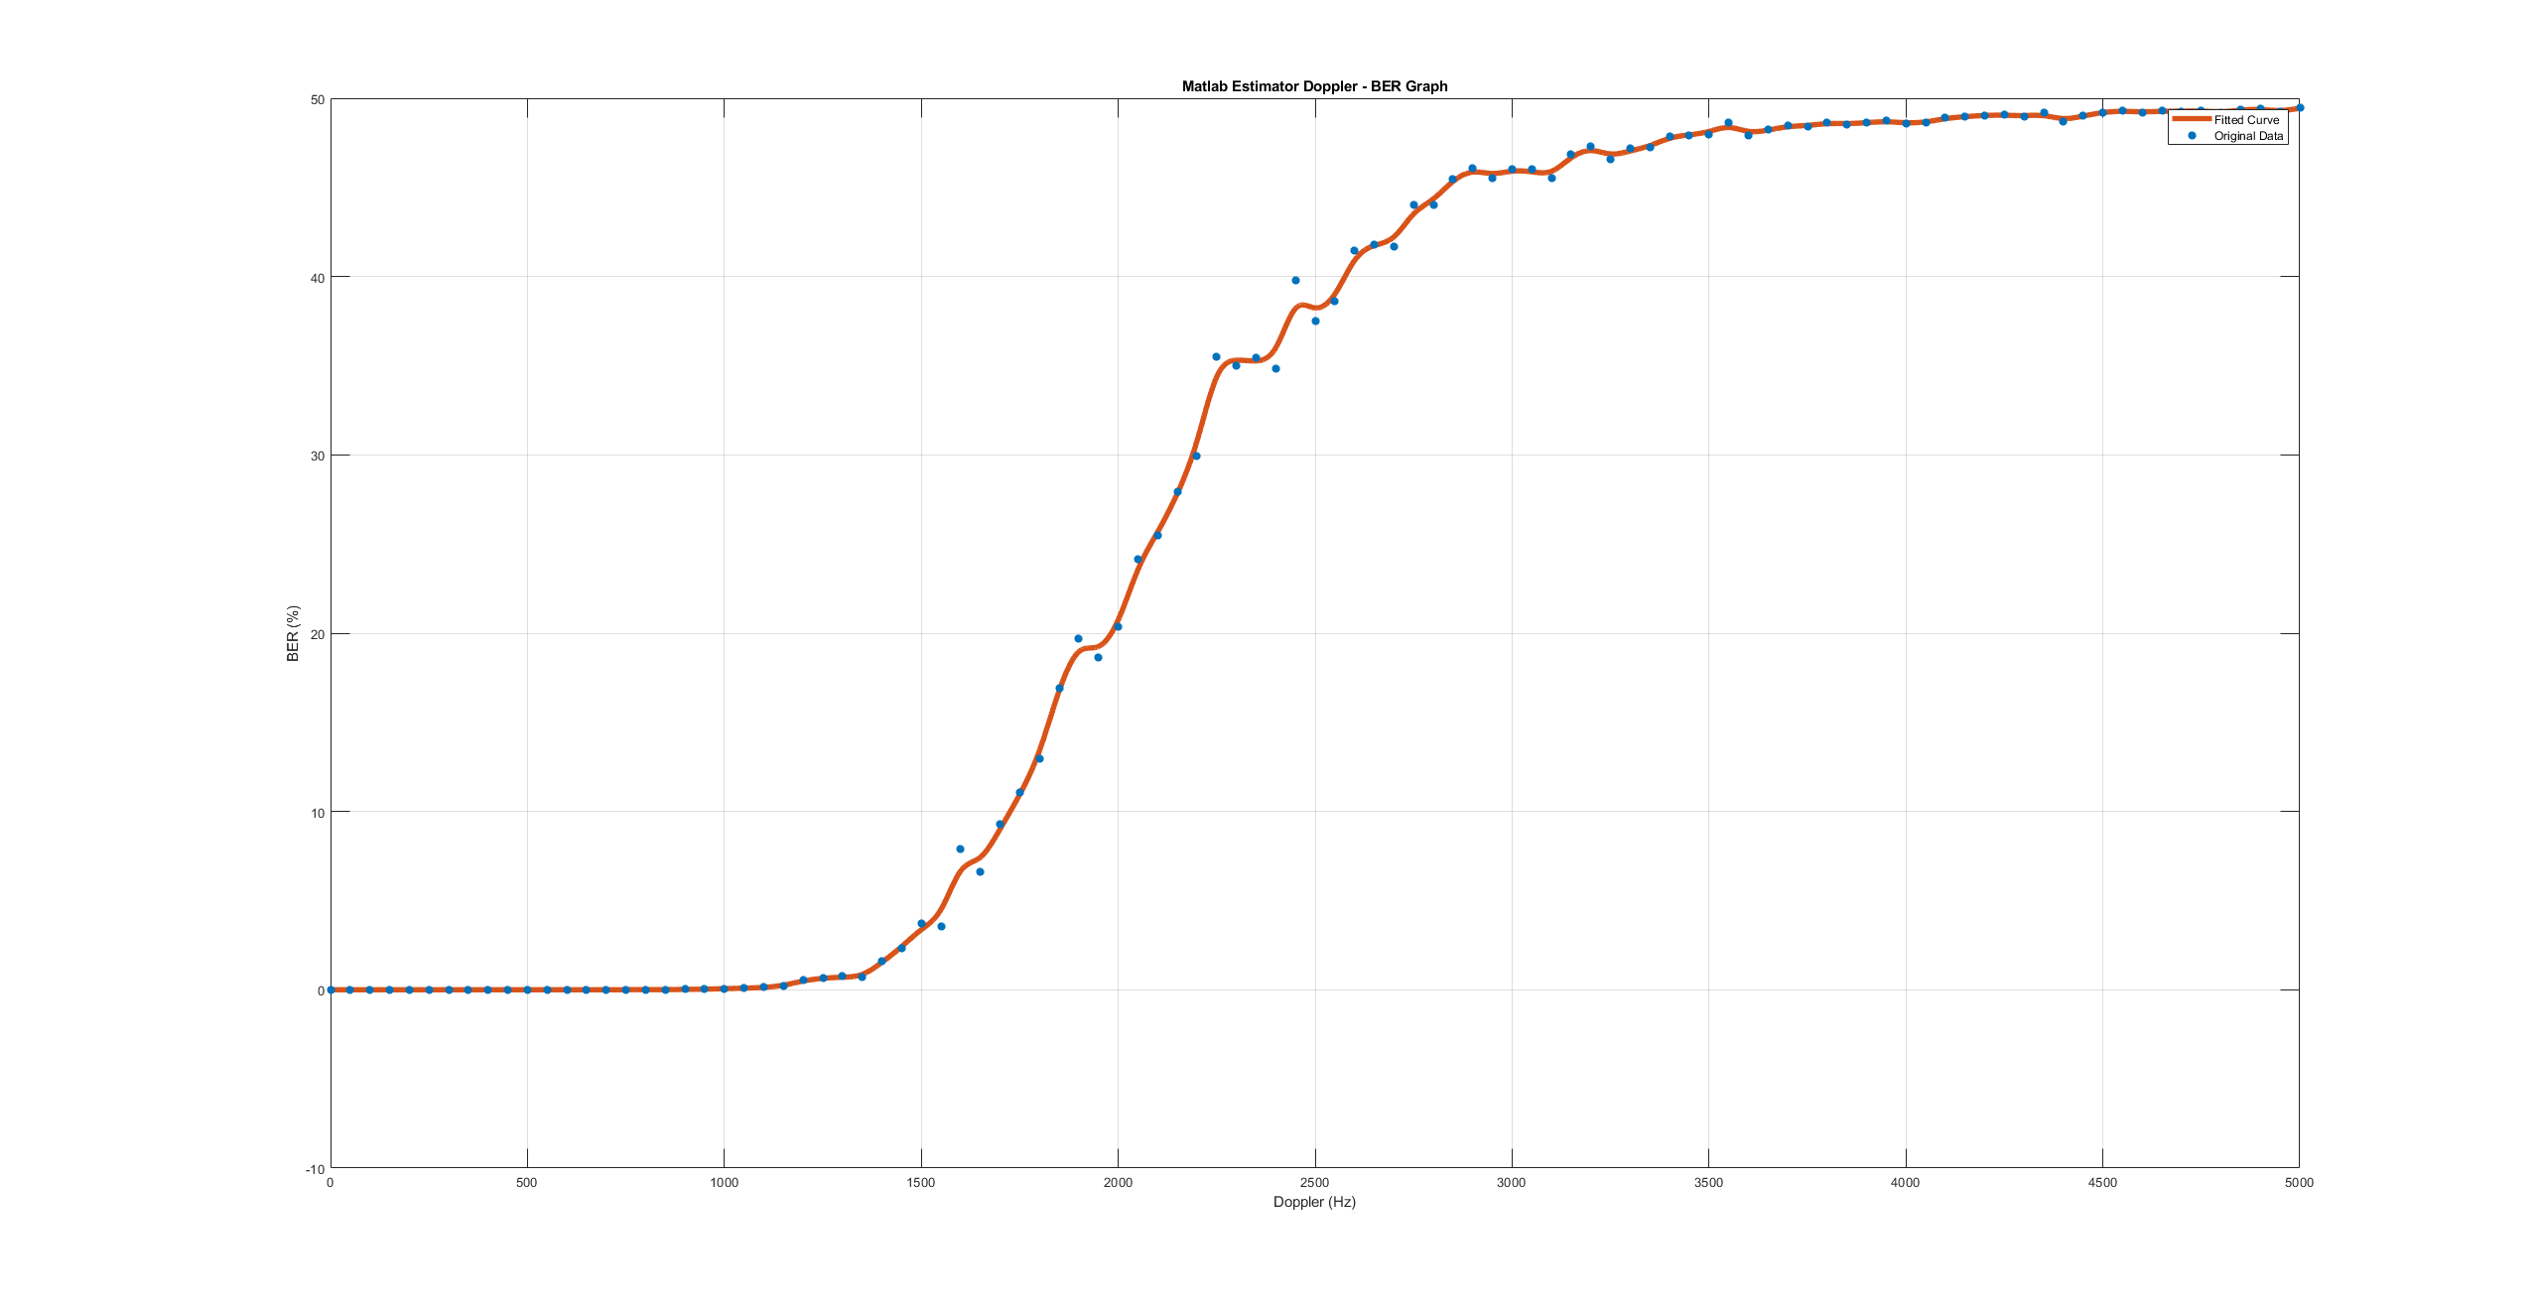
Monte Carlo Simulations: Matlab Estimator

Slide 43
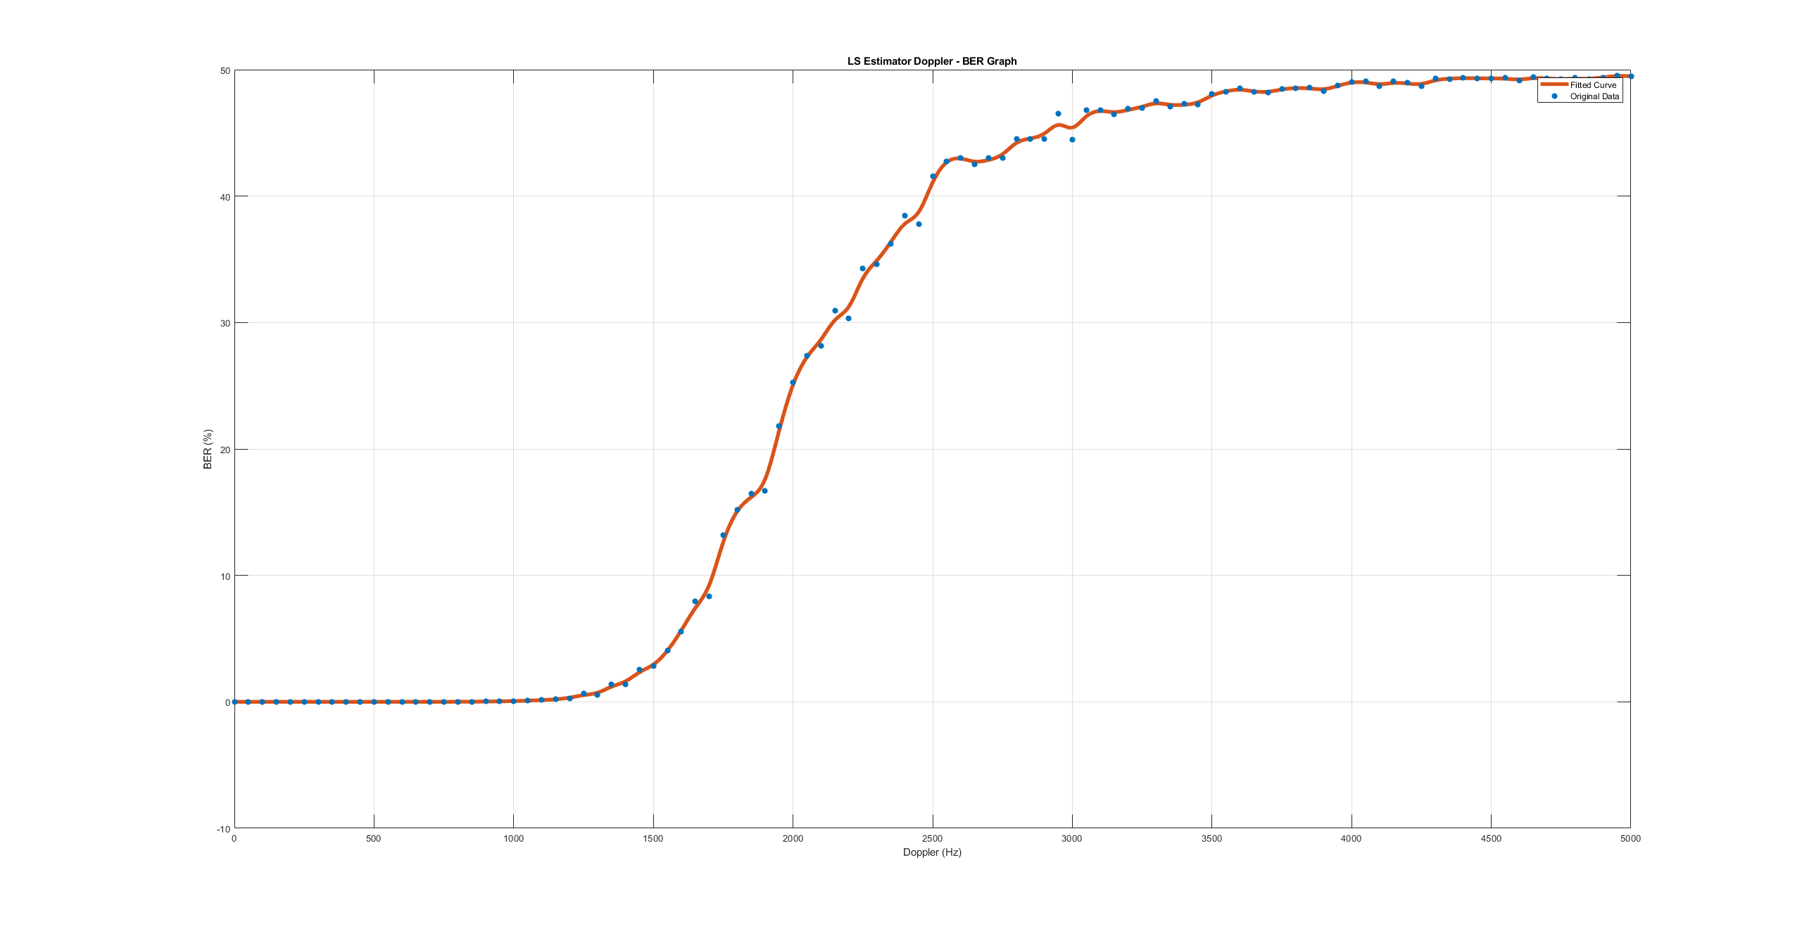
Monte Carlo Simulations: LS Estimator

Slide 44
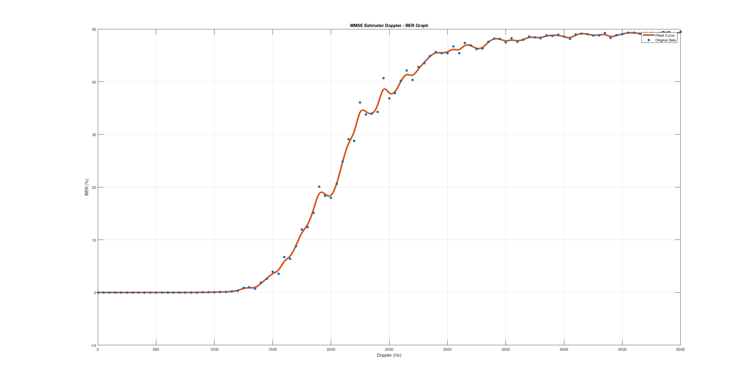
Monte Carlo Simulations: MMSE Estimator

Slide 45
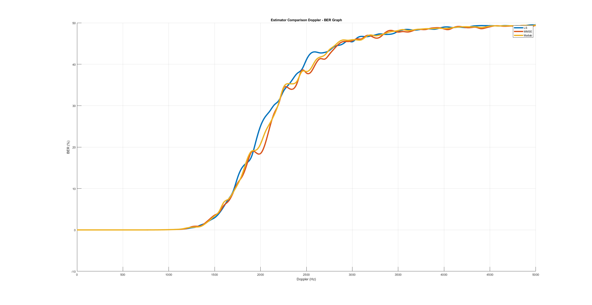
Monte Carlo Simulations: Combined BER-Dopler Graphs
LS Mean BER : 0.284
MMSE Mean BER : 0.279
MATLAB Mean BER : 0.281
Blue: LS, Red: MMSE, Orange: Matlab’s Estimator

Slide 46
cONCLUSıON

Slide 47
Doppler's Impact on IEEE 802.11 Standards
Challenge: BER increases sharply beyond 1700 Hz Doppler, with all estimators failing at high frequencies.
Key Insight: LEO satellites experience Doppler shifts up to 48 kHz, far beyond the capability of IEEE 802.11, designed for static or low-mobility environments.

Slide 48
Attempts to Mitigate Doppler Effects
Payload Reduction: Reducing packet size to 100 bytes improved preamble-based estimation slightly but remains impractical for real-world applications.
Result: BER remains prohibitively high even at lower Doppler frequencies, making decoding unreliable.

Slide 49
Need for Optimized Standards
Limitation: IEEE 802.11 is unsuitable for LEO satellite communications due to its inability to handle high Doppler shifts and dynamic channels.
Solution: Developing OFDM-based communication standards optimized for LEO satellites is essential to ensure robustness and reliable communication.

Slide 50
Referances
MathWorks, "Image transmission and reception using 802.11 waveform with SDR." Accessed: Dec. 25, 2024. [Online]. Available: https://www.mathworks.com/help/wlan/ug/image-transmission-reception-using-802-11-waveform-sdr.html
A. S. Ahmed, M. M. Hamdi, M. S. Abood, A. M. Khaleel, M. Fathy and S. H. Khaleefah, "Channel Estimation using LS and MMSE Channel Estimation Techniques for MIMO-OFDM Systems", HORA 2022 – 4th International Congress on Human-Computer Interaction Optimization and Robotic Applications Proceedings, 2022.
Sriram Tadavarty and Nanda Kishore Chavali, "Estimation and Compensation of Doppler in 5G NR Based Non-Terrestrial Networks", IEEE International Conference on Advanced Networks and Telecommunications Systems ANTS 2022, pp. 135-140, December 18–21, 2022.
Perahia, E., & Stacey, R. (2013). Next Generation Wireless LANs: 802.11n and 802.11ac. Cambridge University Pres

Slide 51
Thank You For LIstening

